Slide 1
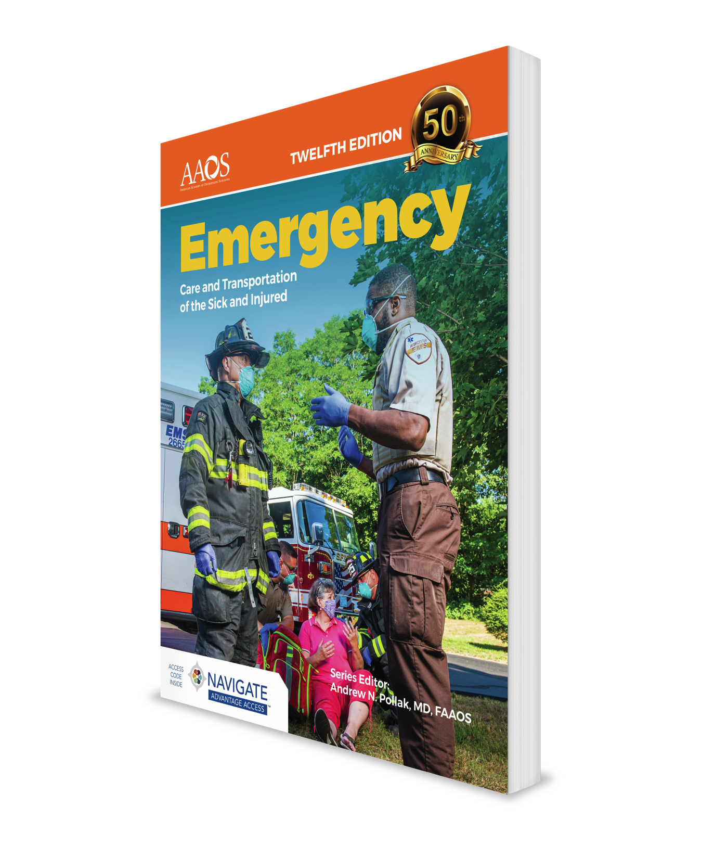
Respiratory Emergencies
CHAPTER 16

Slide 2
National EMS Education Standard Competencies (1 of 5)
Medicine
Applies fundamental knowledge to provide basic emergency care and transportation based on assessment findings for an acutely ill patient.
Notes:
National EMS Education Standard Competencies
Medicine
Applies fundamental knowledge to provide basic emergency care and transportation based on assessment findings for an acutely ill patient.

Slide 3
National EMS Education Standard Competencies (2 of 5)
Respiratory
Anatomy, signs, symptoms, and management of respiratory emergencies, including those that affect the
  Upper airway
  Lower airway
Notes:
National EMS Education Standard Competencies
Respiratory
Anatomy, signs, symptoms, and management of respiratory emergencies, including those that affect the
• Upper airway
• Lower airway

Slide 4
National EMS Education Standard Competencies (3 of 5)
Respiratory (cont’d)
Anatomy, physiology, pathophysiology, assessment, and management of
  Epiglottitis
  Spontaneous pneumothorax
  Pulmonary edema
  Asthma
  Chronic obstructive pulmonary disease
Notes:
National EMS Education Standard Competencies
Anatomy, physiology, pathophysiology, assessment, and management of
• Epiglottitis
• Spontaneous pneumothorax
• Pulmonary edema
• Asthma
• Chronic obstructive pulmonary disease

Slide 5
National EMS Education Standard Competencies (4 of 5)
Respiratory (cont’d)
Anatomy, physiology, pathophysiology, assessment, and management of (cont’d)
  Environmental/industrial exposure
  Toxic gas
  Pertussis
  Cystic fibrosis
  Pulmonary embolism
Notes:
National EMS Education Standard Competencies
• Environmental/industrial exposure
• Toxic gas
• Pertussis
• Cystic fibrosis
• Pulmonary embolism

Slide 6
National EMS Education Standard Competencies (5 of 5)
Respiratory (cont’d)
Anatomy, physiology, pathophysiology, assessment, and management of (cont’d)
  Pneumonia
  Viral respiratory infections
Notes:
National EMS Education Standard Competencies
• Pneumonia
• Viral respiratory infections

Slide 7
Introduction
Patients often complain of dyspnea.
Can be caused by many different conditions
Cause can be difficult to determine.
Notes:
Lecture Outline
I. Introduction
A. EMTs often encounter patients complaining of dyspnea.
B. Dyspnea can be caused by many different conditions.
1. Dyspnea’s cause can be difficult to determine.
2. Even without a definitive diagnosis, you may still be able to save a patient’s life.

Slide 8
Anatomy of the Respiratory System (1 of 4)
Respiratory system includes all the structures that contribute to breathing
  Diaphragm
  Chest wall muscles
  Accessory muscles of breathing
  Nerves to the muscles
Notes:
Lecture Outline
II. Anatomy of the Respiratory System
A. The respiratory system consists of all structures that contribute to breathing, including:
1. Diaphragm
2. Chest wall muscles
3. Accessory muscles of breathing
4. Nerves from the brain and spinal cord to those muscles

Slide 9
Anatomy of the Respiratory System (2 of 4)
Upper airway consists of structures above the vocal cords.
  Nose and mouth
  Jaw
  Oral cavity
  Pharynx
  Larynx
Notes:
Lecture Outline
B. The upper airway consists of all anatomic structures above the vocal cords:
1. Nose and mouth
2. Jaw
3. Oral cavity
4. Pharynx
5. Larynx

Slide 10
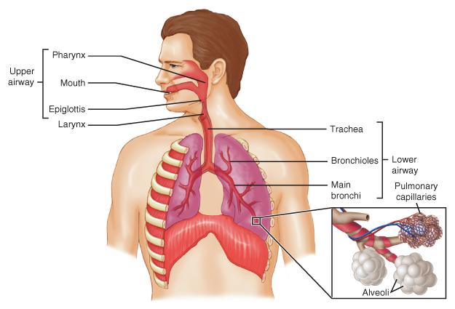
Anatomy of the Respiratory System (3 of 4)
FIGURE 16-1 The upper airway includes the nose, mouth, jaw, oral cavity,
pharynx, and larynx. The lower airway includes the trachea, bronchi,
bronchioles, and alveoli surrounded by the pulmonary capillaries.
© Jones & Bartlett Learning.
Notes:
This figure shows the components of the upper and lower airways.

Slide 11
Anatomy of the Respiratory System (4 of 4)
Principal function of lungs is respiration.
  Exchange of oxygen and carbon dioxide
Air travels through trachea into lungs to:
  Bronchi (larger airways)
  Bronchioles (smaller airways)
  Alveoli (where actual exchange takes place)
Notes:
Lecture Outline
C. The principal function of the lungs is respiration (the exchange of oxygen and carbon dioxide).
D. Air travels through the trachea into the lungs, then on to the:
1. Bronchi
2. Bronchioles
3. Alveoli

Slide 12
Physiology of Respiration (1 of 3)
Respiration process
  Inspiration
  Expiration
Oxygen is provided to the blood.
Carbon dioxide is removed.
Takes place rapidly at level of alveoli
Notes:
Lecture Outline
III. Physiology of Respiration
A. There are two processes that occur during respiration: inspiration and expiration
1. Oxygen is provided to the blood and carbon dioxide is removed from it.
2. In healthy lungs, this exchange of gases takes place rapidly at the level of the alveoli.

Slide 13
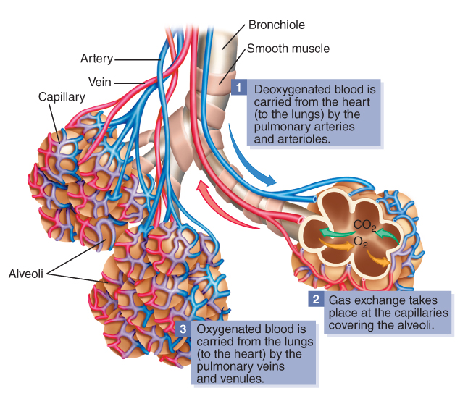
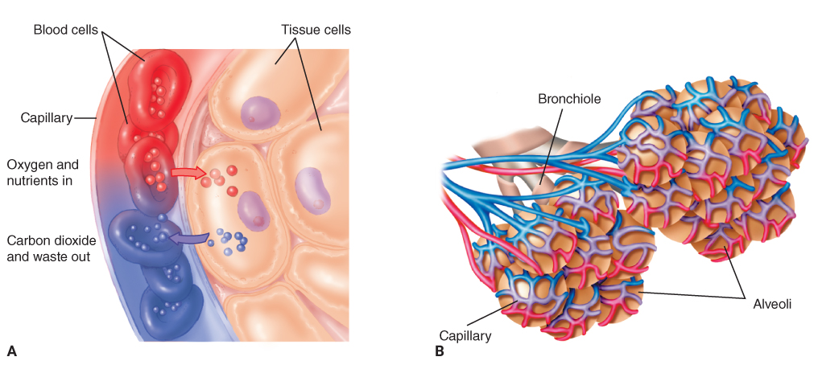
Physiology of Respiration (2 of 3)
FIGURE 16-3 The exchange of oxygen and carbon dioxide in the tissues. A. Oxygen passes from the blood through
capillaries to tissue cells. Carbon dioxide passes from tissue cells through capillaries to the blood. B. In the lungs, oxygen is picked up by the blood, and carbon dioxide is given off.
FIGURE 16-2 An enlarged view of a single alveolus (air sac) showing where the exchange of oxygen and carbon dioxide between air in the sac and blood in the pulmonary capillaries takes place
© Jones & Bartlett Learning.
A, B, C: © Jones & Bartlett Learning.
Notes:
These figures show a close-up of the exchange of oxygen and carbon dioxide within the alveoli.

Slide 14
Physiology of Respiration (3 of 3)
In the alveoli:
  Oxygen passes into capillaries.
  Carbon dioxide returns to lungs.
Brainstem senses blood’s carbon dioxide levels.
  Regulates breathing rate and depth
Notes:
Lecture Outline
B. The alveoli lie against the pulmonary capillary vessels.
1. Oxygen passes freely through tiny passages in the alveolar wall into these capillaries through the process of diffusion.
a. It is then carried to the heart, which pumps the oxygen throughout the body.
2. Carbon dioxide returns to the lungs and is exhaled out of the body.
C. The brainstem senses the level of carbon dioxide in the arterial blood.
1. If the level of carbon dioxide drops too low, the person automatically breathes at a slower rate and less deeply.
2. If the level of carbon dioxide rises above normal the person breathes more rapidly and more deeply.

Slide 15
Pathophysiology (1 of 2)
Oxygen exchange can be hindered by:
  Conditions in the anatomy of the airway
  Disease processes
  Traumatic conditions
  Abnormalities in pulmonary vessels
Notes:
Lecture Outline
IV. Pathophysiology
A. The proper exchange of oxygen and carbon dioxide can be hindered by:
1. Abnormal or pathologic conditions in the anatomy of the airway
2. Disease processes
3. Traumatic conditions
4. Abnormalities in the pulmonary vessels

Slide 16
Pathophysiology (2 of 2)
Recognize the signs and symptoms of inadequate breathing and know what to do about it.
Some patients have chronic carbon dioxide retention.
  Low levels of oxygen control breathing.
  Use caution when administering oxygen.
Notes:
Lecture Outline
B. The EMT must be able to:
1. Recognize the signs and symptoms of inadequate breathing and know what to do about it
C. Carbon dioxide retention and hypoxic drive
1. Patients will sometimes have an elevated level of carbon dioxide in their arterial blood.
a. If levels remain elevated for a period of years, the respiratory center in the brain may not function properly.
b. The brain gradually accommodates high levels of carbon dioxide and then uses a “backup system” to control breathing based on low levels of oxygen, known as hypoxic drive.
c. Use caution when administering oxygen to these patients.

Slide 17
Causes of Dyspnea (1 of 4)
Patients often have dyspnea or hypoxia with:
  Pulmonary edema
  Hay fever
  Pleural effusion
  Obstruction of the airway
  Hyperventilation syndrome
  Environmental/industrial exposure
  Drug overdose
Notes:
Lecture Outline
V. Causes of Dyspnea
A. Dyspnea can be caused by many medical problems.
1. Altered mental status may be a sign that the brain is hypoxic.
2. Patients often have difficulty breathing and/or hypoxia with the following medical conditions:
a. Pulmonary edema
b. Hay fever
c. Pleural effusion
d. Obstruction of the airway
e. Hyperventilation syndrome
f. Environmental/industrial exposure
g. Carbon monoxide poisoning
h. Drug overdose

Slide 18
Causes of Dyspnea (2 of 4)
Dyspneic patients may have:
  Gas exchange obstructed
  Damaged alveoli
  Obstructed air passages
  Obstructed blood flow to the lungs
  Excess fluid in pleural space
Notes:
Lecture Outline
B. Be aware that one or more of the following situations may exist in the dyspneic patient:
1. Gas exchange between the alveoli and pulmonary circulation is obstructed by fluid in the lung, infection, or collapsed alveoli.
2. The alveoli are damaged and cannot transport gases properly across their own walls.
3. The air passages are obstructed by muscle spasm, mucus, or weakened, floppy airway walls.
4. Blood flow to the lungs is obstructed by blood clots.
5. The pleural space is filled with air or excess fluid, so the lungs cannot properly expand.

Slide 19
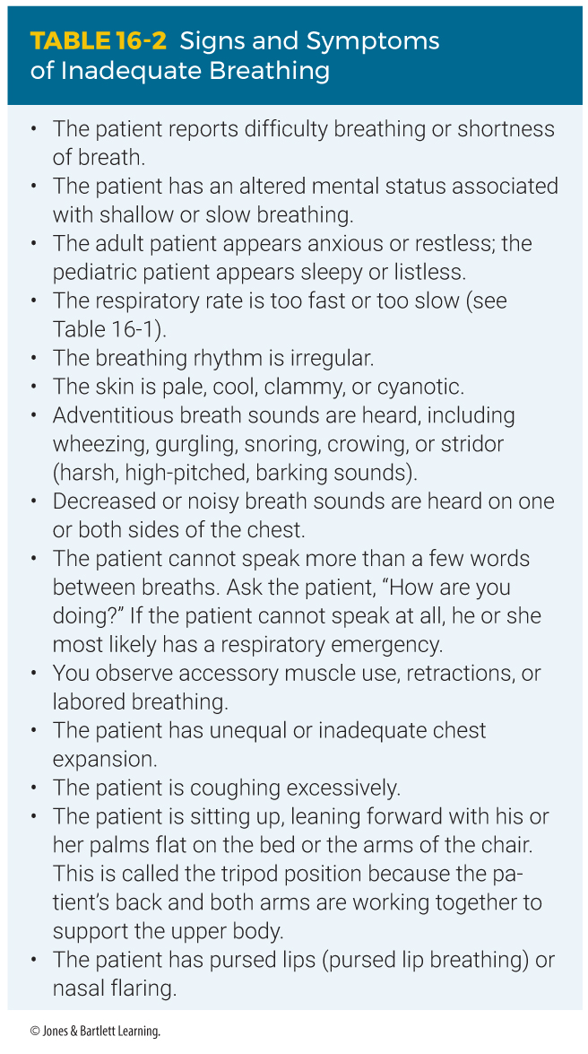
Causes of Dyspnea (3 of 4)
Notes:
This table shows signs and symptoms of inadequate breathing.

Slide 20
Causes of Dyspnea (4 of 4)
Patients may also complain of chest tightness or air hunger.
Common with cardiopulmonary diseases
Pain can cause rapid, shallow breathing.
Notes:
Lecture Outline
C. Dyspnea is a common complaint in patients with cardiopulmonary diseases.
1. Congestive heart failure causes the heart to pump inefficiently and deprives the body of oxygen.
2. Severe pain can cause a patient to experience rapid, shallow breathing without the presence of a primary pulmonary dysfunction.

Slide 21
Upper or Lower Airway Infection
Infectious diseases may affect all parts of the airway.
Some forms of obstruction cause dyspnea.
  Mucus and secretions obstructing airflow in major passages
  Swelling of soft tissues in upper airways
  Impaired exchange of gases in the alveoli
Notes:
Lecture Outline
D. Upper or lower airway infection
1. Infectious diseases causing dyspnea may affect all parts of the airway.
a. Oxygenation is a problem of inadequate oxygen delivery to the tissues.
2. The problem causing dyspnea is always some form of obstruction:
a. Mucus and secretions obstructing airflow in major passages (cold, diphtheria)
b. Swelling of soft tissues in upper airways (epiglottitis, croup)
c. Impaired exchange of gases in the alveoli (pneumonia)
3. Be diligent about the use of appropriate PPE when in contact with patients who have infectious diseases.

Slide 22
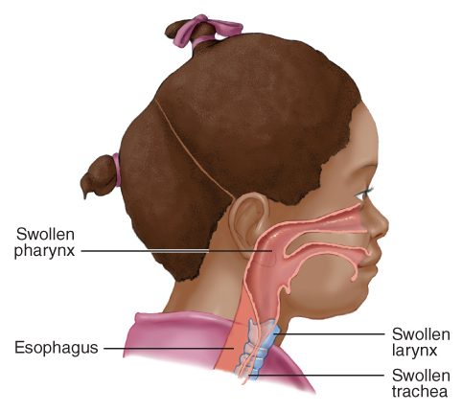
Croup
Inflammation and swelling of pharynx, larynx, and trachea
Stridor and seal-bark cough
Responds well to humidified oxygen
FIGURE 16-4 Croup results in swelling of the whole
airway: pharynx, larynx, and trachea.
© Jones & Bartlett Learning.
Notes:
Lecture Outline
4. Croup
a. Inflammation and swelling of the pharynx, larynx, and trachea
b. Typically seen in children between 6 months and 3 years of age
c. Hallmark signs of croup are stridor and a seal-bark cough.
d. Croup often responds well to the administration of humidified oxygen.

Slide 23
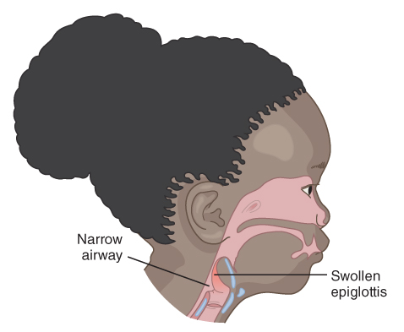
Epiglottitis
Bacterial infection causing inflammation of epiglottis
Children are often found in tripod position and drooling.
Position comfortably and provide oxygen.
FIGURE 16-5 Acute epiglottitis is caused by a bacterial infection that results in severe swelling of the epiglottis, which could obstruct the airway.
© Jones & Bartlett Learning.
Notes:
Lecture Outline
5. Epiglottitis
a. Inflammation of the epiglottis, usually as the result of a bacterial infection
b. More predominant in children but can also occur in adults
c. Children are often found in the tripod position and drooling.
d. Treat them gently and try not to make them cry.
e. Position comfortably, provide high-flow oxygen, and do not put anything in their mouths.

Slide 24
Respiratory Syncytial Virus (RSV)
Common cause of illness in young children
Causes infection in the lungs and passages
Look for signs of dehydration.
Treat airway and breathing problems.
Humidified oxygen is helpful.
Notes:
Lecture Outline
6. Respiratory syncytial virus
a. A common cause of illness in young children.
b. Causes an infection in the lungs and breathing passages and leads to bronchiolitis and pneumonia.
c. Highly contagious.
d. Assess for signs of dehydration and treat airway and breathing problems as appropriate.

Slide 25
Bronchiolitis
Viral illness often caused by RSV
Usually affects newborns and toddlers
Bronchioles become inflamed, swell, and fill with mucus.
Provide oxygen therapy and frequently reassess
Notes:
Lecture Outline
7. Bronchiolitis
a. Viral illness that occurs dues to RSV and usually affects newborns and toddlers
b. Bronchioles become inflamed, swell, and fill with mucus.
c. Provide oxygen therapy and frequently reassess for signs of respiratory distress.

Slide 26
Pneumonia
Bacterial pneumonia will come on quickly and result in high fever.
Viral pneumonia presents more gradually and is less severe.
Especially affects people who are chronically ill
Assess temperature and provide airway support and supplemental oxygen.
Notes:
Lecture Outline
8. Pneumonia
a. General term that refers to an infection of the lungs
b. Often a secondary infection that begins after an upper respiratory tract infection
c. Bacterial pneumonia will come on quickly and result in high fevers.
d. Viral pneumonia presents more gradually and is less severe.
e. Pneumonia especially affects people who are chronically and terminally ill.
f. Assess temperature to determine presence of fever.
g. Provide airway support and supplemental oxygen.

Slide 27
Pertussis
Airborne bacterial infection that mostly affects children younger than 6 years
Patients will be feverish and exhibit a “whoop” sound on inspiration after a coughing attack.
Watch for dehydration and suction as needed.
Notes:
Lecture Outline
9. Pertussis (whooping cough)
a. An airborne bacterial infection that mostly affects children younger than 6 years
b. Patients will be feverish and exhibit a “whoop” sound on inspiration after a coughing attack.
c. Highly contagious and is passed through droplet infection
d. Watch for signs of dehydration.
e. Suction may be necessary.

Slide 28
Influenza Type A
Became pandemic in 2009
Symptoms include fever, cough, sore throat, muscle aches, headache, and fatigue.
May lead to pneumonia or dehydration
Notes:
Lecture Outline
10. Influenza Type A
a. An animal respiratory disease that has mutated to infect humans
b. Transmitted via direct contact with basal secretions and aerosolized droplets from coughing.
c. Symptoms include fever, cough, sore throat, muscle aches, headache, and fatigue.
d. May lead to pneumonia or dehydration

Slide 29
COVID-19 (SARS-CoV-2)
Similar to the virus that causes the common cold
Preferentially affects the elderly, those living in close quarters with one another, and those with weakened immune systems.
Transmitted by aerosol droplets and airborne particles
Respiratory deterioration may occur rapidly.
Notes:
Lecture Outline
11. COVID-19 (SARS-CoV-2)
a. A coronavirus similar to the one that causes the common cold
b. Preferentially affects the elderly, patients living in close quarters with one another, and those with weakened immune systems.
c. Young and healthy individuals can also be infected.
d. Transmitted by aerosol droplets, through airborne particles generated by sneezing or coughing and by direct contact
e. Symptoms include high fever, cough, inspirational chest pain, vomiting and diarrhea, and anosmia (inability to smell).
f. Respiratory deterioration may occur rapidly.

Slide 30
Tuberculosis (TB)
Bacterial infection that most often affects the lungs
Can remain inactive for years
Patients often complain of fever, coughing, fatigue, night sweats, and weight loss.
Wear gloves, eye protection, and an N-95 respirator (at a minimum).
Notes:
Lecture Outline
12. Tuberculosis (TB)
a. TB is a bacterial infection that most commonly affects the lungs, but it can also be found in almost any other organ.
b. Can remain inactive for years before producing any symptoms
c. Patients often complain of fever, coughing, fatigue, night sweats, and weight loss.
d. Prevalence is higher in homeless people, prison inmates, nursing home residents, persons who abuse intravenous drugs or alcohol, and those with HIV.
e. If you suspect your patient may have active TB, you need to wear (at a minimum) your gloves, eye protection, and an N-95 respirator.

Slide 31
Acute Pulmonary Edema (1 of 2)
Heart muscle cannot circulate blood properly.
Fluid builds up within alveoli and in lung tissue.
  Usually result of congestive heart failure
  Most patients have a long-standing history of chronic congestive heart failure.
  In severe cases, a frothy pink sputum forms at the nose and mouth.
Notes:
Lecture Outline
E. Acute pulmonary edema
1. The left side of the heart cannot remove blood from the lung as fast as the right side delivers it.
2. Fluid builds up within the alveoli and in lung tissue.
3. Usually results from congestive heart failure
4. Patient usually experiences dyspnea with rapid, shallow respirations.
5. In severe cases, a frothy pink sputum forms at the nose and mouth.
6. Most patients have a long-standing history of chronic congestive heart failure that can be kept under control with medication.
7. Not all patients with pulmonary edema have heart disease.

Slide 32
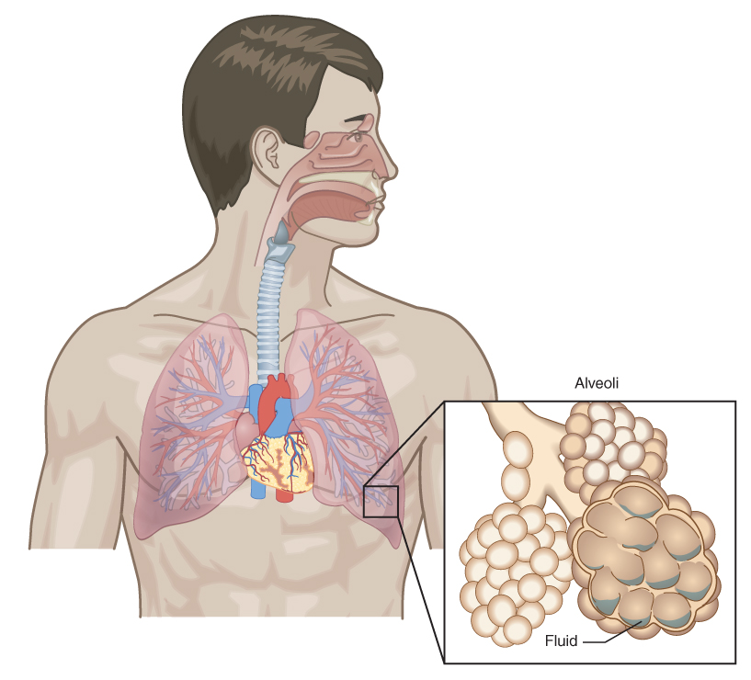
Acute Pulmonary Edema (2 of 2)
FIGURE 16-6 In pulmonary edema, fluid fills the alveoli and separates the capillaries from the alveolar wall, interfering with the exchange of oxygen and carbon dioxide.
© Jones & Bartlett Learning
Notes:
This figure shows fluid filling the alveoli in pulmonary edema.

Slide 33
Chronic Obstructive Pulmonary Disease (COPD) (1 of 4)
Slow process of dilation and disruption of airways and alveoli
Caused by chronic bronchial obstruction
Tobacco smoke can create chronic bronchitis.
Notes:
Lecture Outline
F. Chronic Obstructive Pulmonary Disease (COPD)
1. A lung disease characterized by chronic obstruction of lung airflow that interferes with normal breathing and is not fully reversible.
2. Umbrella term used to describe a few lung diseases, including emphysema and chronic bronchitis
3. Tobacco smoke is a bronchial irritant and can create chronic bronchitis, an ongoing irritation of the trachea and bronchi.
a. With bronchitis, excessive mucus is constantly produced, obstructing small airways and alveoli.
b. Airways are weakened and the protective cells and lung mechanisms that remove foreign particles are destroyed..
c. Chronic oxygenation problems can also lead to right heart failure and fluid retention.
i. Pneumonia develops easily.
ii. Repeated episodes of irritation and pneumonia cause scarring in the lung and some dilation of the obstructed alveoli, leading to COPD.

Slide 34
Chronic Obstructive Pulmonary Disease (COPD) (2 of 4)
Emphysema is most common type of COPD.
  Loss of elastic material in the lungs
  Causes include inflamed airways, smoking.
Most patients with COPD have elements of both chronic bronchitis and emphysema.
Notes:
Lecture Outline
4. Emphysema is the most common type of COPD.
a. Emphysema is the loss of elastic material in the lungs as a result of chronic stretching of the alveoli.
b. Smoking can directly destroy the elasticity of the lung tissue.
5. Most patients with COPD have elements of both chronic bronchitis and emphysema.

Slide 35
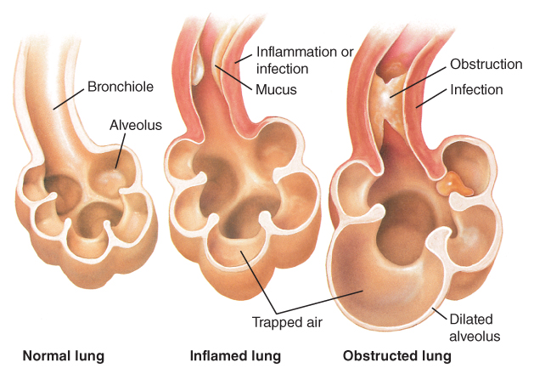
Chronic Obstructive Pulmonary Disease (COPD) (3 of 4)
FIGURE 16-7 Repeated episodes of irritation and inflammation in the alveoli result in the obstruction, scarring, and some dilation of the alveolar sac characteristic of COPD.
© Jones & Bartlett Learning.
Notes:
This figure shows damage to the alveoli characteristic of COPD.

Slide 36
Chronic Obstructive Pulmonary Disease (COPD) (4 of 4)
Patients with pulmonary edema will have “wet” lung sounds.
Patients with COPD will have “dry” lung sounds.
Can be easily confused with congestive heart failure
Treat the patient, not the lung sounds.
Notes:
Lecture Outline
6. Wet lungs versus dry lungs
a. Patients with pulmonary edema caused most often by congestive heart failure will often have “wet” lung sounds (rhonchi, crackles), and patients with COPD will often have “dry” lung sounds (wheezes).
b. Do not assume that all COPD patients have wheezing and all congestive heart failure patients have crackles.
c. Treat the patient, not the lung sounds

Slide 37
Asthma, Hay Fever, and Anaphylaxis (1 of 4)
Result of allergic reaction to inhaled, ingested, or injected substance
  In some cases, allergen cannot be identified.
In some cases, there is no identifiable allergen.
Notes:
Lecture Outline
G. Asthma, hay fever, and anaphylaxis
1. Asthma, hay fever, and anaphylaxis result from an allergic reaction to an inhaled, ingested, or injected substance.

Slide 38
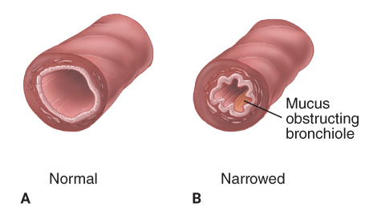
Asthma, Hay Fever, and Anaphylaxis (2 of 4)
Asthma is acute spasm of smaller air passages (bronchioles), associated with excessive mucus production and swelling of the mucus membranes.
FIGURE 16-8 Asthma is an inflammation of the lungs
associated with excessive mucus production and
swelling of the bronchioles. A. Cross section of a normal
bronchiole. B. The bronchiole in spasm; a mucus plug has
formed and partially obstructed the bronchiole.
A, B: © Jones & Bartlett Learning
Notes:
Lecture Outline
2. Asthma
a. An acute spasm of the bronchioles associated with excessive mucus production and swelling of the mucous lining of the respiratory passages

Slide 39
Asthma, Hay Fever, and Anaphylaxis (3 of 4)
Asthma affects all ages.
  Most prevalent in children 5–17 years
Produces characteristic wheezing
Asthma attack may be caused by allergic reaction to foods or allergens or severe emotional distress, exercise, and respiratory infections.
Notes:
Lecture Outline
b. Affects all ages but is most prevalent in children 5–17 years of age
c. Produces a characteristic wheezing as the patient attempts to exhale through partially obstructed airways
d. An acute asthma attack may be caused by allergic reaction to specific foods or some other allergen.
e. Attacks may also be caused by severe emotional distress, exercise, and respiratory infections.
f. In its most severe form, an allergic reaction can produce anaphylaxis.

Slide 40
Asthma, Hay Fever, and Anaphylaxis (4 of 4)
Hay fever causes cold-like symptoms.
  Allergens include pollen, dust mites, pet dander.
Anaphylactic reaction can produce severe airway swelling.
  Total obstruction is possible.
  Treat with epinephrine, oxygen, and antihistamines.
Notes:
Lecture Outline
3. Hay fever (allergic rhinitis)
a. Causes cold-like symptoms, including a runny nose, sneezing, congestion, and sinus pressure
b. Symptoms are caused by an allergic reaction, usually to outdoor, airborne allergens.
4. Anaphylactic reactions
a. Severe allergic reaction characterized by severe airway swelling and dilation of the blood vessels all over the body.
b. May be associated with widespread hives, itching, signs of shock, and signs and symptoms similar to asthma.
c. The airway can swell so much that total obstruction is possible.
d. Epinephrine is the treatment of choice, and oxygen and antihistamines are helpful.

Slide 41
Spontaneous Pneumothorax (1 of 2)
Pneumothorax is accumulation of air in pleural space.
Most often caused by trauma
May be caused by medical conditions
  Spontaneous pneumothorax
Notes:
Lecture Outline
H. Spontaneous pneumothorax
1. Pneumothorax is the partial or total accumulation of air in the pleural space.
2. It is most often caused by trauma, but may also be caused by medical conditions (“spontaneous pneumothorax”)

Slide 42
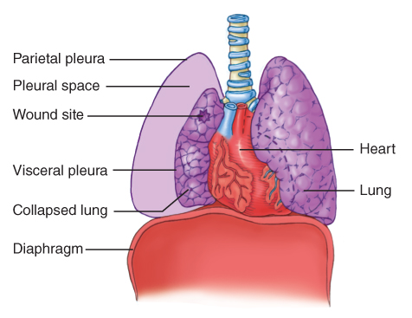
Spontaneous Pneumothorax (2 of 2)
Occurs with lung infections or in weak lungs
Patient becomes dyspneic.
Breath sounds may be absent on affected side.
FIGURE 16-10 A pneumothorax occurs when air leaks into the pleural space from an opening in the chest wall or the surface of the lung. The lung collapses as air fills the pleural space and the two pleural surfaces are no longer in contact.
© Jones & Bartlett Learning
Notes:
Lecture Outline
3. A vacuum-like pressure in the pleural space keeps the lungs inflated.
a. When the surface of the lung is disrupted, air escapes into the pleural cavity and the negative vacuum pressure is lost.
4. Spontaneous pneumothorax occurs in patients with certain chronic lung infections or in young people born with weak areas of the lung.
5. A patient with spontaneous pneumothorax becomes dyspneic and might complain of pleuritic chest pain.
Breath sounds are absent or decreased on the affected side.
Has the potential to evolve into a life-threatening pneumothorax.

Slide 43
Pleural Effusion
Collection of fluid outside the lung
Compresses lung and causes dyspnea
Can stem from irritation, infection, congestive heart failure, or cancer
Upright position eases pain.
Notes:
Lecture Outline
I. Pleural effusion
1. A collection of fluid outside the lung.
2. It compresses the lung and causes dyspnea.
3. It can be caused by an irritation, infection, congestive heart failure, or cancer.
4. Breath sounds will be decreased over the area where the effusion is present.
5. Patients feel better if they are sitting upright.

Slide 44
Obstruction of the Airway (1 of 2)
Patient with dyspnea may have mechanical obstruction.
In unconscious patients, obstruction may be caused by aspiration of vomitus or tongue blocking the airway.
If patient was eating just before dyspnea, always consider foreign body obstruction.
Notes:
Lecture Outline
J. Obstruction of the airway
1. A patient with dyspnea may have a mechanical obstruction.
2. In semiconscious and unconscious patients, the obstruction may be the result of aspirations of vomitus or a foreign object, or improper positioning of the head, causing the tongue to block the airway.
3. If the patient was eating just before onset of the dyspnea, always consider the possibility of foreign body obstruction.

Slide 45
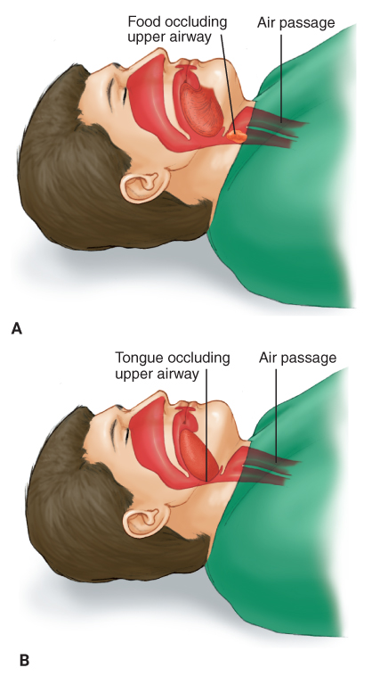
Obstruction of the Airway (2 of 2)
FIGURE 16-12 A. Foreign body obstruction occurs when an object, such as food, is lodged in the airway. B. Mechanical obstruction also occurs when the head is
not properly positioned, causing the tongue to fall back into the throat.
© Jones & Bartlett Learning
Notes:
These figures show obstruction of the airway by a foreign body (A) and the tongue (B).

Slide 46
Pulmonary Embolism (1 of 2)
A blood clot that circulates through the venous system
  Circulation cut off partially or completely
  Significantly decreases blood flow
  If large enough, can cause sudden death
Notes:
Lecture Outline
K. Pulmonary embolism
1. An embolus is anything in the circulatory system that moves from its point of origin to a distant site and lodges there, obstructing subsequent blood flow in that area.
a. Circulation can be cut off completely or partially.
b. Emboli can be fragments of blood clots in an artery or vein that break off and travel through the bloodstream, or foreign bodies such as a bubble of air.
2. A pulmonary embolism is a blood clot that circulates through the venous system and the right side of the heart and lodges in the pulmonary artery.

Slide 47
Pulmonary Embolism (2 of 2)
Signs and symptoms include:
  Dyspnea
  Tachycardia
  Tachypnea
  Varying degrees of hypoxia
  Cyanosis
  Acute chest pain
  Hemoptysis
Notes:
Lecture Outline
a. Signs and symptoms of pulmonary emboli include the following:
i. Dyspnea
ii. Tachycardia
iii. Tachypnea
iv. Varying degrees of hypoxia
v. Cyanosis
vi. Acute chest pain
vii. Hemoptysis
b. With a large enough embolism, complete obstruction of the output of blood from the right side of the heart can result in sudden death.

Slide 48
Hyperventilation (1 of 2)
Overbreathing to the point that arterial carbon dioxide falls below normal
May be indicator of life-threatening illness
Body may be trying to compensate for acidosis.
  Buildup of excess acid in blood or body tissues
Notes:
Lecture Outline
L. Hyperventilation
1. Defined as overbreathing to the point that the level of arterial carbon dioxide falls below normal.
a. This may be an indicator of a life-threatening illness.
2. The body may be trying to compensate for acidosis (the buildup of excess acid in blood or body tissues)

Slide 49
Hyperventilation (2 of 2)
Can result in alkalosis
  Buildup of excess base in body fluids
Can cause symptoms of panic attack:
  Anxiety
  Dizziness
  Numbness
  Tingling or painful spasms of the hands/feet
Notes:
Lecture Outline
Can result in alkalosis
a. This can cause symptoms of hyperventilation syndrome (panic attack), including:
i. Anxiety
ii. Dizziness
iii. Numbness
iv. Tingling of the hands and feet
v. Painful spasms of the hands and/or feet (carpopedal spasms)
4. The decision whether hyperventilation is being caused by a life-threatening illness or a panic attack should not be made outside the hospital.

Slide 50
Environmental/Industrial Exposure
Pesticides, cleaning solutions, chemicals, chlorine, and other gases can be released.
Carbon monoxide
  Odorless
  Highly poisonous
  Produced by fuel-burning appliances and smoke.
Do not put yourself at risk.
Notes:
Lecture Outline
M. Environmental/industrial exposure
1. Pesticides, cleaning solutions, chemicals, chlorine, and other gases can be accidentally released at industrial sites and inhaled by employees.
2. Carbon monoxide poisoning
a. Carbon monoxide is odorless and highly poisonous.
b. Leading cause of accidental poisoning deaths in the United States
c. Carbon monoxide is produced by fuel-burning household appliances and is present in smoke.
d. People who have carbon monoxide poisoning complain of flu-like symptoms and even dyspnea.
e. Do not put yourself at risk.
f. High-flow oxygen by nonrebreathing mask is the best treatment for conscious patients.

Slide 51
Scene Size-up
Scene safety
  Use standard precautions and PPE.
  Consider possibility of infectious disease or toxic substance.
Mechanism of injury/nature of illness
  If in question, ask why 9-1-1 was activated.
  Question the patient, family, and/or bystanders to determine NOI.
Notes:
Lecture Outline
VI. Patient Assessment
A. Scene size-up
1. Use standard precautions and use PPE.
a. Consider the possibility of an infectious disease or toxic substance.
b. If there are multiple people with dyspnea, consider the possibility of an airborne hazardous material release.
2. If the mechanism of injury/nature of illness is in question, ask why 9-1-1 was activated.
a. By questioning the patient, family, and/or bystanders, you should be able to determine the NOI.

Slide 52
Primary Assessment (1 of 5)
Identify immediate life threats.
Form a general impression.
  Note age and position of patient.
  Use AVPU scale.
  Ask patient about chief complaint.
Notes:
Lecture Outline
B. Primary assessment
1. Identify immediate life threats.
2. Form an overall general impression of the patient’s level of distress.
a. Note the age and position of the patient.
b. Use AVPU scale to check for responsiveness.
c. Ask the patient about his or her chief complaint.

Slide 53
Primary Assessment (2 of 5)
Airway and breathing
  Make sure airway is patent and adequate.
  Assess rate, rhythm, and quality.
  Ask the following questions:
    Is the air going in?
    Does the chest rise and fall with each breath?
    Is the rate adequate for the victim’s age?
Notes:
Lecture Outline
3. Assessing ABCs
a. Make sure airway is patent and adequate.
b. Evaluate whether the patient’s breathing is adequate.

Slide 54
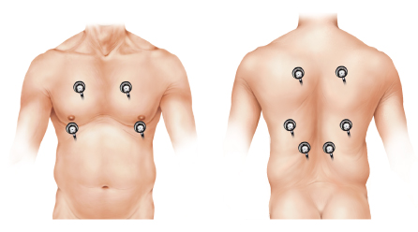
Primary Assessment (3 of 5)
Assess breath sounds
  Check breath sounds on the right and left sides of the chest.
  Abnormal sounds include wheezing, rales, rhonchi, and stridor.
FIGURE 16-15 Locations of the stethoscope bell for
auscultation of breath sounds.
© Jones & Bartlett Learning.
Notes:
Lecture Outline
c. Assess breath sounds.

Slide 55
Primary Assessment (4 of 5)
Circulation
  Assess pulse rate, rhythm, and quality.
  Evaluate for shock and bleeding.
  Assess perfusion by evaluating skin color, temperature, and condition.
Notes:
Lecture Outline
4. Assess circulation.
a. Assess pulse rate, rhythm, and quality.
b. Evaluate for shock and bleeding.
c. Assess perfusion by evaluating skin color, temperature, and condition.

Slide 56
Primary Assessment (5 of 5)
Transport decision
  If condition is unstable and there is possible life threat:
    Address the life threat.
    Proceed with rapid transport.
Notes:
Lecture Outline
5. Make transport decision.
a. Address the life threat.
b. Proceed with rapid transport.

Slide 57
History Taking (1 of 2)
Investigate chief complaint.
Find out what the patient has done for the breathing problem.
SAMPLE history
Notes:
Lecture Outline
C. History taking
1. Investigate the patient’s chief complaint. and determine what the patient has done for the breathing problem.
2. With patients in respiratory distress, a SAMPLE history can be collected from bystanders or family, if they are present.

Slide 58
History Taking (2 of 2)
OPQRST assessment
  Onset, provocation/palliation, quality, radiation/region, severity
PASTE assessment
  Specific for patients with dyspnea
  Progression, associated chest pain, sputum, talking tiredness, exercise tolerance
Notes:
Lecture Outline
3. The OPQRST assessment can be used to assess for pain and gather information about the breathing problem.
4. The PASTE assessment is an alternative assessment for a complaint of shortness of breath or difficulty breathing.
a. Progression
b. Associated chest pain
c. Sputum
d. Talking tiredness
e. Exercise tolerance

Slide 59
Secondary Assessment (1 of 2)
More in-depth assessment of body systems
Proceed only after addressing life-threats.
Use monitoring devices if you have them.
Notes:
Lecture Outline
D. Secondary assessment
1. Only proceed with secondary assessment if life threats have been addressed and treated.
2. Use monitoring devices if you have them.

Slide 60
Secondary Assessment (2 of 2)
Look for signs of COPD
  Patient older than 50 years of age
  History of lung problems
  Active or former cigarette smoker
  Tightness in chest
  Constant fatigue
  Barrel-like appearance to chest
  Use of accessory muscles
  Abnormal breath sounds
Notes:
Lecture Outline
3. Secondary assessment of COPD versus congestive heart failure.
a. Patients with COPD:
i. Are usually older than 50 years of age
ii. Often have a history of lung problems
iii. Are almost always long-term active or former cigarette smokers
iv. Complain of tightness in the chest and constant fatigue
v. Chest may have a barrel-like appearance.
vi. Often use accessory muscles to breathe
vii. Exhibit abnormal breath sounds
viii. Often exhale through pursed lips
ix. Have digital clubbing (abnormal enlargement of the ends of the fingers)

Slide 61
Reassessment
Repeat the primary assessment.
  Assess for changes in condition.
Interventions may include:
  Oxygen via nonrebreathing mask at 15 L/min
  Positive pressure ventilations
  Airway management techniques
  Positioning in high Fowler position or position of choice
  Assisting with respiratory medications
Notes:
Lecture Outline
E. Reassessment
1. Repeat the primary assessment.
a. Determine if there have been changes in the patient’s condition.
b. Confirm the adequacy of interventions and patient status.
2. Interventions for respiratory problems may include:
a. Providing oxygen via nonrebreathing mask at 15 L/min
b. Providing positive pressure ventilations using a bag-mask device; pocket mask; or flow-restricted, oxygen-powered device
c. Using airway management techniques such as an oropharyngeal airway, nasopharyngeal airway, suctioning, airway positioning
d. Providing noninvasive ventilator support CPAP
e. Positioning the patient in a high Fowler position or position of choice
f. Assisting the patient with respiratory medications
3. Communicate all relevant information to the staff at the receiving hospital.

Slide 62
Emergency Medical Care (1 of 2)
Administer supplemental oxygen.
Some patients may need CPAP or bag-mask device.
Patient may have metered-dose inhaler (MDI) or small-volume nebulizer.
Consult medical control and make sure medication is indicated.
Notes:
Lecture Outline
VII. Emergency Medical Care
A. Management of respiratory distress
1. Administer supplemental oxygen immediately.
2. Administer ventilatory support if the patient’s mental status is declining, if they are in moderate to severe respiratory distress, or if the depth of respiration is inadequate.
3. Monitor the patient’s respiratory status.
4. Provide emotional support.
5. The patient may have a metered-dose inhaler (MDI) or small-volume nebulizer.
a. Consult medical control and make sure the medication is indicated.

Slide 63
Emergency Medical Care (2 of 2)
Ensure there are no contraindications
Most medications are used relax the muscles that surround the air passages in the lungs.
Common side effects of inhalers:
  Increased pulse rate
  Nervousness
  Muscle tremors
Notes:
Lecture Outline
b. Ensure that there are no contraindications to the patient’s condition:
c. Most respiratory inhalation medications are used relax the muscles that surround the air passages in the lungs, leading to dilation of the airways.
d. Common side effects of inhalers:
i. Increased pulse rate
ii. Nervousness
iii. Muscle tremors
e. Medication from an inhaler is delivered through the respiratory tract to the lung.
f. Follow the steps in Skill Drill 16-1 to help a patient self-administer medication from an MDI.
g. Follow the steps in Skill Drill 16-2 to help a patient self-administer medication from a small-volume nebulizer.

Slide 64
Treatment of Specific Conditions (1 of 12)
Upper or lower airway infection
  Administer humidified oxygen (if available).
  Do not attempt to suction the airway or place an oropharyngeal airway.
  Position comfortably.
  Transport promptly.
Notes:
Lecture Outline
VIII. Treatment of Specific Conditions
A. Upper or lower airway infection
1. Administer humidified oxygen (if available).
2. Do not attempt to suction the airway or place an oropharyngeal airway in a patient with suspected epiglottitis.
3. Position comfortably.
4. Transport promptly.

Slide 65
Treatment of Specific Conditions (2 of 12)
Acute pulmonary edema
  Provide 100% oxygen.
  Suction if necessary.
  Position comfortably.
  Provide CPAP if indicated and allowed by protocol.
  Transport promptly.
Notes:
Lecture Outline
B. Acute pulmonary edema
1. Provide 100% oxygen.
2. Suction, if necessary
3. Position comfortably.
4. Provide CPAP if indicated and allowed by protocol.
5. Transport promptly.

Slide 66
Treatment of Specific Conditions (3 of 12)
Chronic obstructive pulmonary disease
  Assist with prescribed inhaler.
    Watch for side effects from overuse.
  Position comfortably.
  Transport promptly.
Notes:
Lecture Outline
C. COPD
1. Assist with prescribed inhaler.
a. Watch for side effects due to overuse.
2. Position comfortably.
3. Transport promptly.

Slide 67
Treatment of Specific Conditions (4 of 12)
Asthma
  Be prepared to suction.
  Assist asthma patient with prescribed inhaler.
  Provide aggressive airway management, oxygen, and prompt transport.
Notes:
Lecture Outline
D. Asthma, hay fever, and anaphylaxis
1. Asthma
a. Be prepared to suction.
b. Assist the asthma patient with prescribed inhaler.
c. Provide aggressive airway management, oxygen, prompt transport.

Slide 68
Treatment of Specific Conditions (5 of 12)
Hay fever
  Unlikely to need emergency treatment
Anaphylaxis
  Remove the offending agent.
  Maintain the airway.
  Transport rapidly.
  Administer epinephrine.
Notes:
Lecture Outline
2. Hay fever
a. Hay fever is unlikely to need emergency treatment.
b. Manage the airway and give oxygen according to the level of distress.
3. Anaphylaxis
a. Remove the offending agent.
b. Provide aggressive airway management, oxygen and prompt transport.
c. Administer epinephrine if allowed by local protocol.

Slide 69
Treatment of Specific Conditions (6 of 12)
Spontaneous pneumothorax
  Provide supplemental oxygen.
  Transport promptly.
  Monitor carefully.
Pleural effusion
  Fluid removal must be done in hospital.
  Provide oxygen.
  Transport promptly.
Notes:
Lecture Outline
E. Spontaneous pneumothorax
1. Provide supplemental oxygen.
2. Transport promptly.
3. Monitor carefully.
F. Pleural effusion
1. Fluid removal must be done in hospital.
2. Provide oxygen and transport promptly.

Slide 70
Treatment of Specific Conditions (7 of 12)
Obstruction of airway
  Partial obstruction
    Provide supplemental oxygen and transport.
  Complete obstruction
    Clear obstruction and administer oxygen.
  Transport rapidly to emergency department.
Notes:
Lecture Outline
G. Obstruction of the airway
1. Partial obstruction: Provide supplemental oxygen and transport.
2. Complete obstruction: Clear the obstruction and administer oxygen.
3. Transport rapidly to emergency department.

Slide 71
Treatment of Specific Conditions (8 of 12)
Pulmonary embolism
  Supplemental oxygen is mandatory.
  Position comfortably.
  If hemoptysis is present, clear airway immediately.
  Transport promptly.
Notes:
Lecture Outline
H. Pulmonary embolism
1. Supplemental oxygen is mandatory.
2. Position comfortably.
3. If hemoptysis is present, clear the airway immediately.
4. Transport promptly.

Slide 72
Treatment of Specific Conditions (9 of 12)
Hyperventilation
  Complete primary assessment and gather history.
  Do not have patient breathe into paper bag.
  Reassure the patient and provide supplemental oxygen.
  Transport promptly.
Notes:
Lecture Outline
I. Hyperventilation
1. Complete primary assessment and gather history.
2. Do not have patient breathe into a paper bag.
3. Reassure the patient and provide supplemental oxygen.
4. Transport promptly.

Slide 73
Treatment of Specific Conditions (10 of 12)
Environmental/industrial exposure
  Ensure patients are decontaminated.
  Treat with oxygen, adjuncts, and suction based on presentation.
Notes:
Lecture Outline
J. Environmental/industrial exposure
1. Ensure patients are decontaminated.
2. Treat with oxygen, adjuncts, and suction based on presentation.

Slide 74
Treatment of Specific Conditions (11 of 12)
Foreign body aspiration
  Clear the airway.
  Provide oxygen and transport.
Tracheostomy dysfunction
  Position comfortably.
  Suction to clear the obstruction.
  Provide oxygen.
Notes:
Lecture Outline
K. Foreign body aspiration
1. Perform the appropriate airway clearing technique specific to age.
2. Provide oxygen and transport.
L. Tracheostomy dysfunction
1. Position comfortably.
2. Provide suctioning to clear the obstruction.
3. Once the obstruction is clear, oxygenate the patient.

Slide 75
Treatment of Specific Conditions (12 of 12)
Asthma
  Provide blow-by oxygen.
  Use MDIs.
Cystic fibrosis
  Genetic disorder that affects the lungs and digestive system
  Suction and oxygenate as needed.
Notes:
Lecture Outline
M. Asthma
1. For children:
a. Provide blow-by oxygen by holding the mask in front of the child’s face.
b. Use MDIs as you would with older patients.
2. As with any chronic disease, asthma may be life threatening in an older person.
N. Cystic fibrosis
1. Genetic disorder that affects the lungs and digestive system
a. Predisposes children to repeated lung infections
2. Symptoms range from sinus congestion to wheezing and asthma-like complaints.
3. Suction and oxygenate as needed.

Slide 76
Review
The process in which oxygen and carbon dioxide are exchanged in the lungs is called:
  respiration.
  ventilation.
  metabolism.
  inhalation.

Slide 77
Review
Answer: A
Rationale: Respiration is defined as the exchange of gases between the body and its environment. The exchange of oxygen and carbon dioxide in the lungs is called pulmonary (external) respiration. The exchange of oxygen and carbon dioxide at the cellular level is called cellular (internal) respiration.

Slide 78
Review
The process in which oxygen and carbon dioxide are exchanged in the lungs is called:
  respiration.
  Rationale: Correct answer
  ventilation.
  Rationale: Ventilation is the exchange of air between the lungs and the environment.
  metabolism.
  Rationale: Metabolism is the series of processes by which food is converted into the energy and products needed to sustain life.
  inhalation.
  Rationale: Inhalation is the active, muscular part of breathing.

Slide 79
Review
Which of the following respiratory diseases causes obstruction of the lower airway?
  Croup
  Asthma
  Epiglottitis
  Laryngitis

Slide 80
Review
Answer: B
Rationale: Asthma is a lower airway disease that causes the bronchioles in the lungs to constrict (bronchospasm), resulting in various degrees of obstruction. Croup, epiglottitis, and laryngitis cause swelling, inflammation, and varying degrees of obstruction of the upper airway.

Slide 81
Review
Which of the following respiratory diseases causes obstruction of the lower airway?
  Croup
  Rationale: This causes an upper airway obstruction.
  Asthma
  Rationale: Correct answer
  Epiglottitis
  Rationale: This causes an upper airway obstruction.
  Laryngitis
  Rationale: This causes an upper airway obstruction.

Slide 82
Review
Which of the following diseases is potentially drug resistant and is thought to be transmitted by coughing?
  Tuberculosis
  Croup
  Diphtheria
  Epiglottitis

Slide 83
Review
Answer: A
Rationale: Tuberculosis is a bacterial infection spread by cough. It is dangerous because many strains are resistant to antibiotics.

Slide 84
Review
Which of the following diseases is potentially drug resistant and is thought to be transmitted by coughing?
  Tuberculosis
  Rationale: Correct answer
  Croup
  Rationale: Croup is an inflammatory condition of the larynx and trachea, marked by a cough, hoarseness, and difficulty in breathing.
  Diphtheria
  Rationale: Diphtheria is caused by a bacterium that attacks the membranes of the throat.
  Epiglottitis
  Rationale: Epiglottitis is an acute bacterial infection of the epiglottis.

Slide 85
Review
All of the following are causes of acute dyspnea, EXCEPT:
  asthma.
  emphysema.
  pneumothorax.
  pulmonary embolism.

Slide 86
Review
Answer: B
Rationale: Emphysema—a form of COPD—is a chronic respiratory disease; therefore, it presents with progressively worsening dyspnea. Asthma, pulmonary embolism, and pneumothorax are all acute conditions; therefore, they typically present with an acute onset of dyspnea.

Slide 87
Review
All of the following are causes of acute dyspnea, EXCEPT:
  asthma.
  Rationale: Asthma is an acute condition with a sudden onset of dyspnea.
  emphysema.
  Rationale: Correct answer
  pneumothorax.
  Rationale: Pneumothorax is an acute condition with a sudden onset of dyspnea.
  pulmonary embolism.
  Rationale: Pulmonary embolism is an acute condition with a sudden onset of dyspnea.

Slide 88
Review
Bronchospasm is MOST often associated with:
  asthma.
  bronchitis.
  pneumonia.
  pneumothorax.

Slide 89
Review
Answer: A
Rationale: Asthma—a reactive airway disease—is caused by bronchospasm (sustained constriction of the bronchioles). Common triggers to an acute asthma attack include environmental allergens, stress, and temperature changes.

Slide 90
Review
Bronchospasm is MOST often associated with:
  asthma.
  Rationale: Correct answer
  bronchitis.
  Rationale: Bronchitis is the inflammation of the mucous membrane in the bronchial tubes of the lungs.
  pneumonia.
  Rationale: Pneumonia is an inflammation of one or both lungs.
  pneumothorax.
  Rationale: Pneumothorax is the presence of air or gas in the pleural cavity surrounding the lungs, causing pain and difficulty in breathing.

Slide 91
Review
A sudden onset of difficulty breathing, sharp chest pain, and cyanosis that persists despite supplemental oxygen is MOST consistent with:
  severe pneumonia.
  myocardial infarction.
  a pulmonary embolism.
  a spontaneous pneumothorax.

Slide 92
Review
Answer: C
Rationale: Signs of an acute pulmonary embolism include a sudden onset of difficulty breathing, sharp (pleuritic) chest pain, and cyanosis that persists despite the administration of high-flow oxygen. Patients who are immobile for prolonged periods of time (eg, confined to a hospital bed) are prone to a pulmonary embolism.

Slide 93
Review
A sudden onset of difficulty breathing, sharp chest pain, and cyanosis that persists despite supplemental oxygen is MOST consistent with:
  severe pneumonia.
  Rationale: This is an acute bacterial or viral infection associated with a fever, cough, and productive sputum.
  myocardial infarction.
  Rationale: A heart attack is associated with chest pain, sudden onset of weakness, nausea, sweating, and discomfort.
  a pulmonary embolism.
  Rationale: Correct answer
  a spontaneous pneumothorax.
  Rationale: This is when air escapes into the pleural cavity.

Slide 94
Review
Albuterol, a beta-2 agonist, is the generic name for:
  Alupent.
  Metaprel.
  Brethine.
  Ventolin.

Slide 95
Review
Answer: D
Rationale: Albuterol is the generic name for Ventolin (Proventil). Albuterol is a beta-agonist, which dilates the bronchioles, and is commonly used to treat patients with asthma and other reactive airway diseases.

Slide 96
Review
Albuterol, a beta-2 agonist, is the generic name for:
  Alupent.
  Rationale: This is the trade name for metaproterenol, also a beta-2 agonist.
  Metaprel.
  Rationale: This is the trade name for metaproterenol, also a beta-2 agonist.
  Brethine.
  Rationale: This is the trade name for terbutaline, also a beta-2 agonist.
  Ventolin.
  Rationale: Correct answer

Slide 97
Review
An acute bacterial infection that results in swelling of the flap that covers the larynx during swallowing is called:
  croup.
  laryngitis.
  epiglottitis.
  diphtheria.

Slide 98
Review
Answer: C
Rationale: Epiglottitis—a potentially life-threatening illness—is an acute bacterial infection that causes swelling of the epiglottis (the flap the covers the larynx during swallowing). It is characterized by a sudden onset of high fever, difficulty breathing, stridor, drooling, and varying degrees of hypoxemia.

Slide 99
Review
An acute bacterial infection that results in swelling of the flap that covers the larynx during swallowing is called:
  croup.
  Rationale: This is an inflammatory condition of the larynx and trachea, marked by a cough, hoarseness, and difficulty in breathing.
  laryngitis.
  Rationale: This is an inflammation of the larynx, usually accompanied by hoarseness and coughing.
  epiglottitis.
  Rationale: Correct answer
  diphtheria.
  Rationale: This is caused by a bacterium that attacks the membranes of the throat.

Slide 100
Review
A 70-year-old man recently had a heart attack and now complains of severe difficulty breathing, especially when lying flat. He is coughing up pink, frothy secretions. This patient is MOST likely experiencing:
  acute right heart failure.
  severe left heart failure.
  an acute onset of bronchitis.
  an acute pulmonary embolism.

Slide 101
Review
Answer: B
Rationale: As a result of his recent heart attack, the left side of this patient’s heart has been severely damaged. The left side of the heart is responsible for pumping oxygenated blood to the rest of the body. When it fails to do this, blood backs up into the lungs, resulting in pulmonary edema. Signs of pulmonary edema include dyspnea (especially when lying flat); rapid and shallow respirations; and, in severe cases, coughing up of pink, frothy sputum.

Slide 102
Review
A 70-year-old man recently had a heart attack and now complains of severe difficulty breathing, especially when lying flat. He is coughing up pink, frothy secretions. This patient is MOST likely experiencing:
  acute right heart failure.
  Rationale: Acute heart failure causes a backup of blood into the systemic circulatory system and typically causes symptoms of peripheral edema in the hands and feet.
  severe left heart failure.
  Rationale: Correct answer
  an acute onset of bronchitis.
  Rationale: This is an acute inflammation of the lungs associated with a cough, increased sputum, fever, and tachypnea.
  an acute pulmonary embolism.
  Rationale: This is a blood clot in the lungs and is seen as dyspnea, acute chest pain, cyanosis, tachypnea, and coughing up of blood.

Slide 103
Review
Which of the following patients is breathing adequately?
  36-year-old man with cyanosis around the lips and irregular respirations
  29-year old woman with respirations of 20 breaths/min, who is conscious and alert
  22-year-old man with labored respirations at a rate of 28 breaths/min and pale skin
  59-year-old woman with difficulty breathing, whose respirations are rapid and shallow

Slide 104
Review
Answer: B
Rationale: Adequate breathing in the adult is characterized by a respiratory rate between 12 and 20 breaths/min, good chest rise (indicates adequate tidal volume), unlabored breathing effort, nonaltered mental status, and good perfusion to the skin (ie, pink, warm, dry).

Slide 105
Review
Which of the following patients is breathing adequately?
  36-year-old man with cyanosis around the lips and irregular respirations
  Rationale: A patient with irregular respirations is not breathing adequately. Cyanosis is a sign of hypoxia.
  29-year old woman with respirations of 20 breaths/min, who is conscious and alert
  Rationale: Correct answer
  22-year-old man with labored respirations at a rate of 28 breaths/min and pale skin
  Rationale: The normal adult rate of respirations is 12–20 breaths/min.
  59-year-old woman with difficulty breathing, whose respirations are rapid and shallow
  Rationale: A patient with adequate breathing has a normal rate and an unlabored breathing effort.

